Slide 2
Computational approaches for the therapeutic target discovery to ame-liorate muscle wasting during aging and disease
Msc Karen Guerrero Vazquez
Dr. Katarzyna Whysall
Dr. Pilib O Broin

Slide 3
Update # 3

Slide 4
Content
Summary
Pathway analysis
MicroArray analysis
Network analysis
Notes:
We mentioned that aging have a lot of factors attached to it, in the specific case of Sarcopenia we can include chronic inflammation, increased reactive oxidative species, and increased fibrosis of muscle, among others have been reported to contribute to development of sarcopenia

Slide 5
Summary
Notes:
We mentioned that aging have a lot of factors attached to it, in the specific case of Sarcopenia we can include chronic inflammation, increased reactive oxidative species, and increased fibrosis of muscle, among others have been reported to contribute to development of sarcopenia

Slide 6
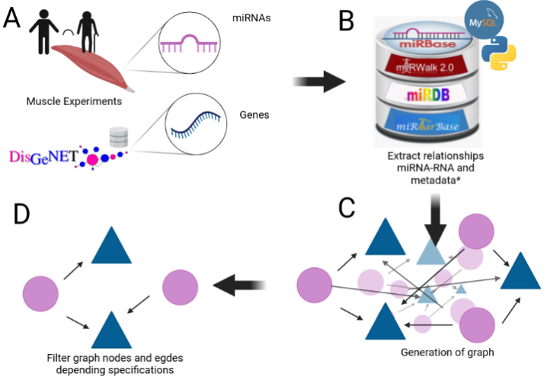
Notes:
We mentioned that aging have a lot of factors attached to it, in the specific case of Sarcopenia we can include chronic inflammation, increased reactive oxidative species, and increased fibrosis of muscle, among others have been reported to contribute to development of sarcopenia

Slide 7
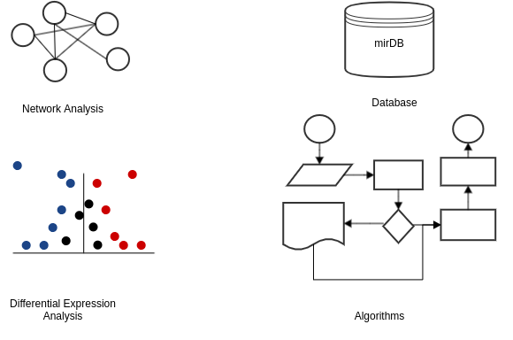
Key points

Slide 8
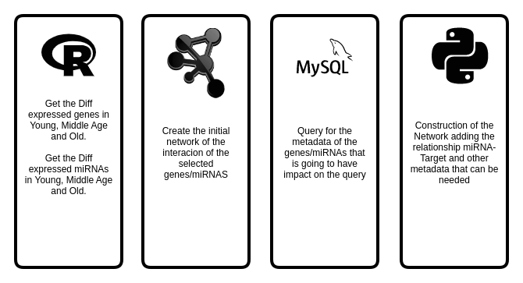
Key points

Slide 9
Gene expression during aging
Young = (0, 35]
MA = (35,65)
Old = [65, inf)

Slide 10
My Experiments
Target | Type | N. Experiments
mRNA | RNASeq | 3
 | MicroArray | 4
miRNA | MicroArray | 1
 | miRSeq | 2
Proteomics | - | 1

Slide 11
Experiment | Evaluation | Regulation | Genes
GSE152558 | MO | Down | 9
GSE152558 | MO | UP | 8
GSE157585 | YO | Down | 73
GSE157585 | YO | UP | 9
GSE164471 | OY | Down | 8
GSE164471 | OY | UP | 5
GSE164471 | MY | Down | 2
GSE164471 | MY | UP | 2
GSE164471 | MO | Down | 11
GSE164471 | MO | UP | 6
GSE875105 | OY | Down | 88
GSE875105 | OY | Up | 18
GSE875105 | MO | Up | 6
GSE23527 | YO | Down | 5
GSE23527 | YO | Up | 1
Notes:
We mentioned that aging have a lot of factors attached to it, in the specific case of Sarcopenia we can include chronic inflammation, increased reactive oxidative species, and increased fibrosis of muscle, among others have been reported to contribute to development of sarcopenia

Slide 12
Pathway Analysis

Slide 13
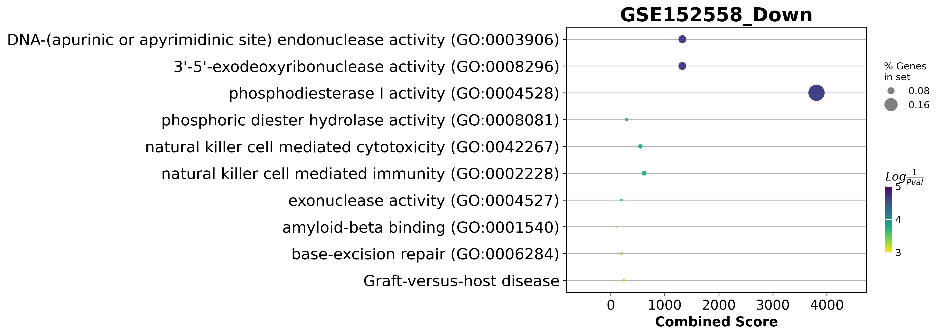
GSE152558 Dotplot

Slide 14
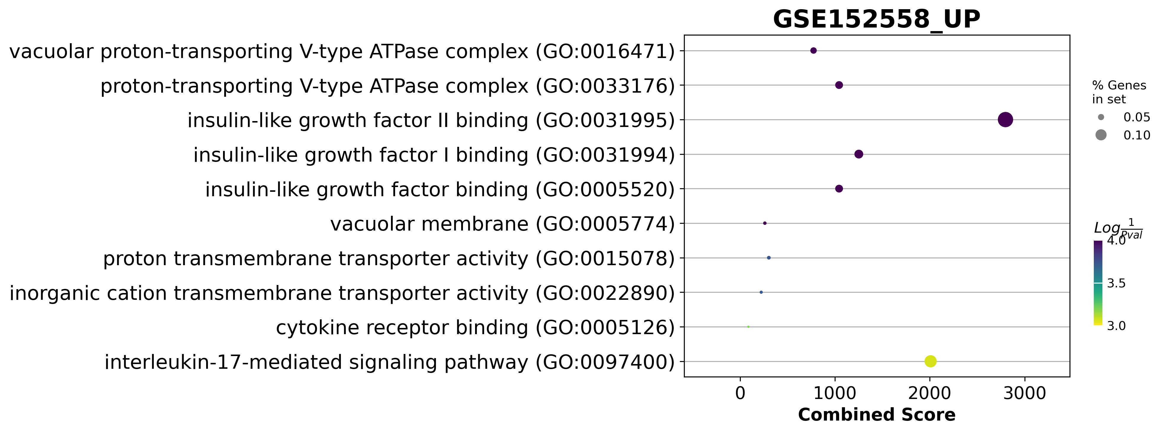
GSE152558 Dotplot

Slide 15
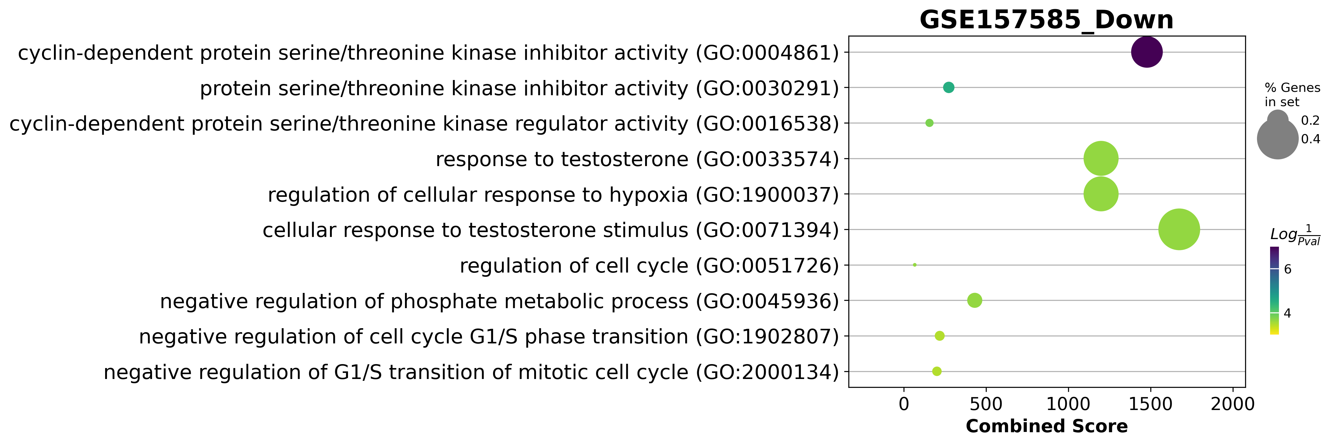
GSE157585 Dotplot

Slide 16
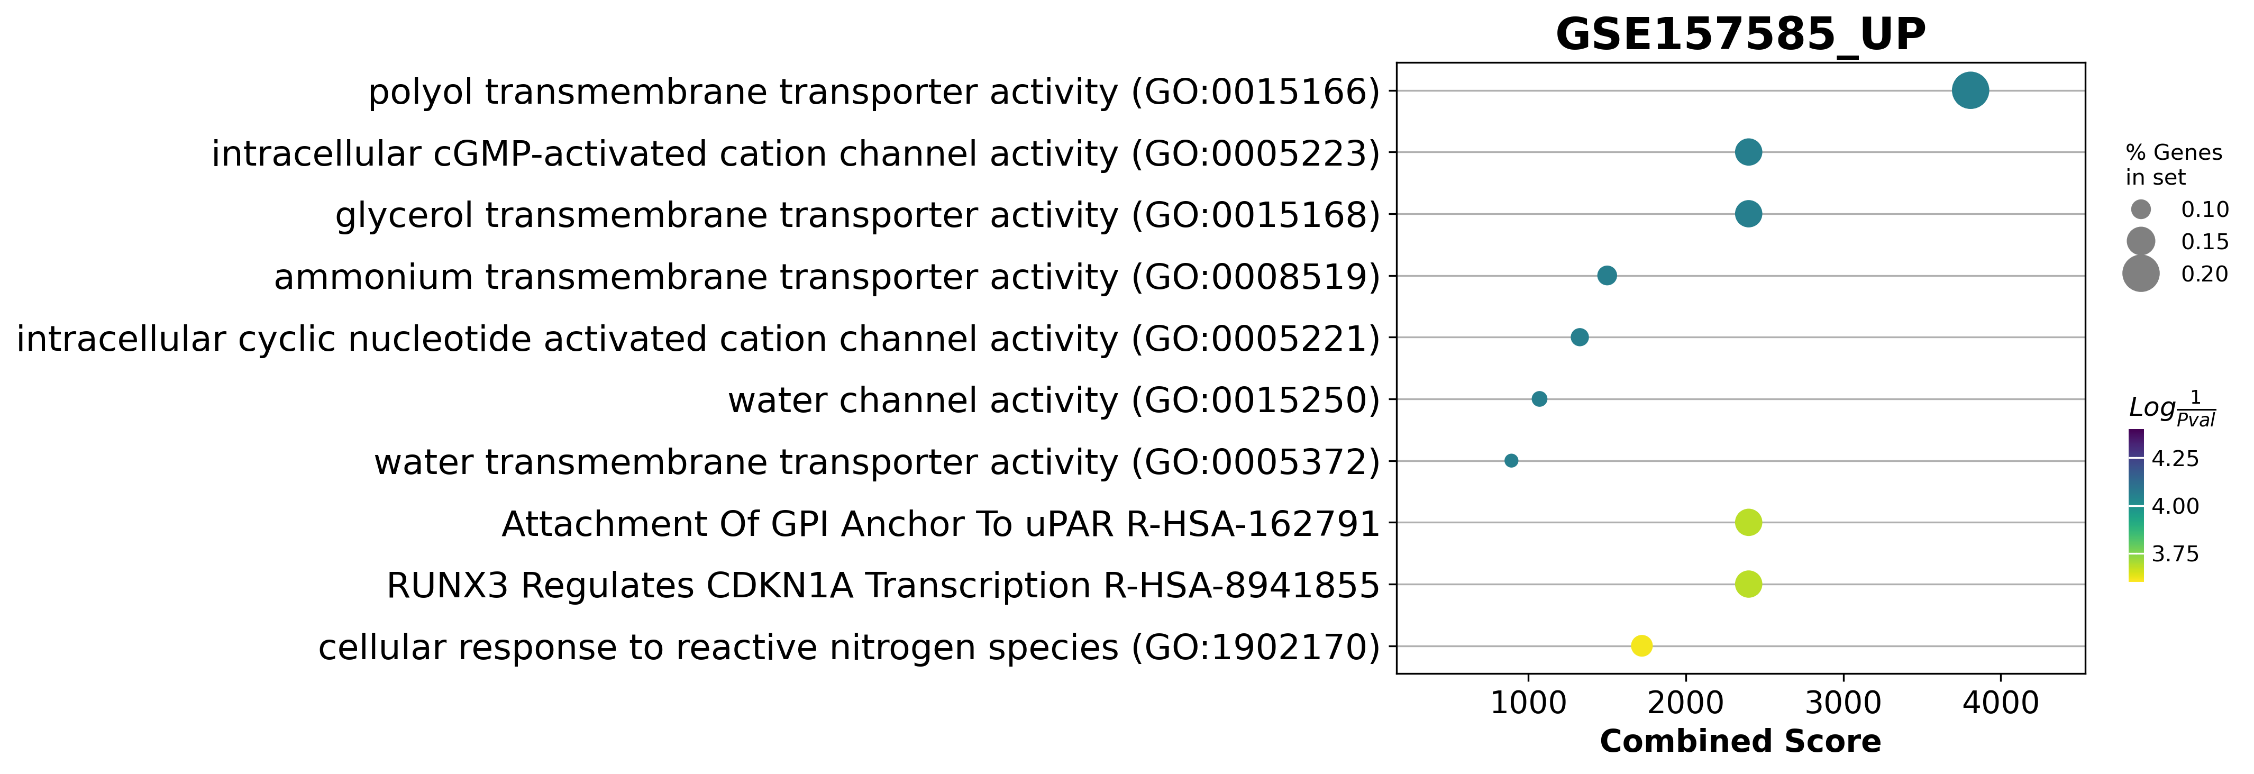
GSE157585 Dotplot

Slide 17
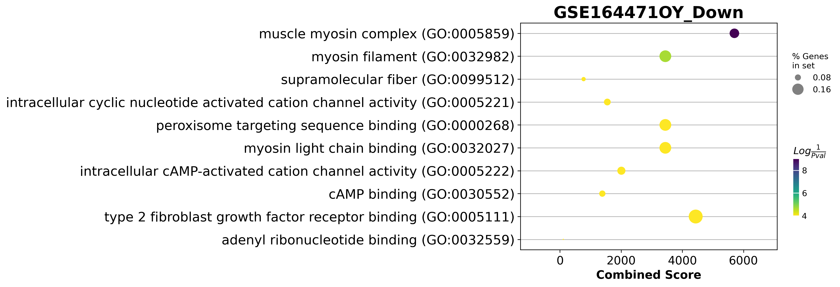
GSE164471 Dotplot

Slide 18
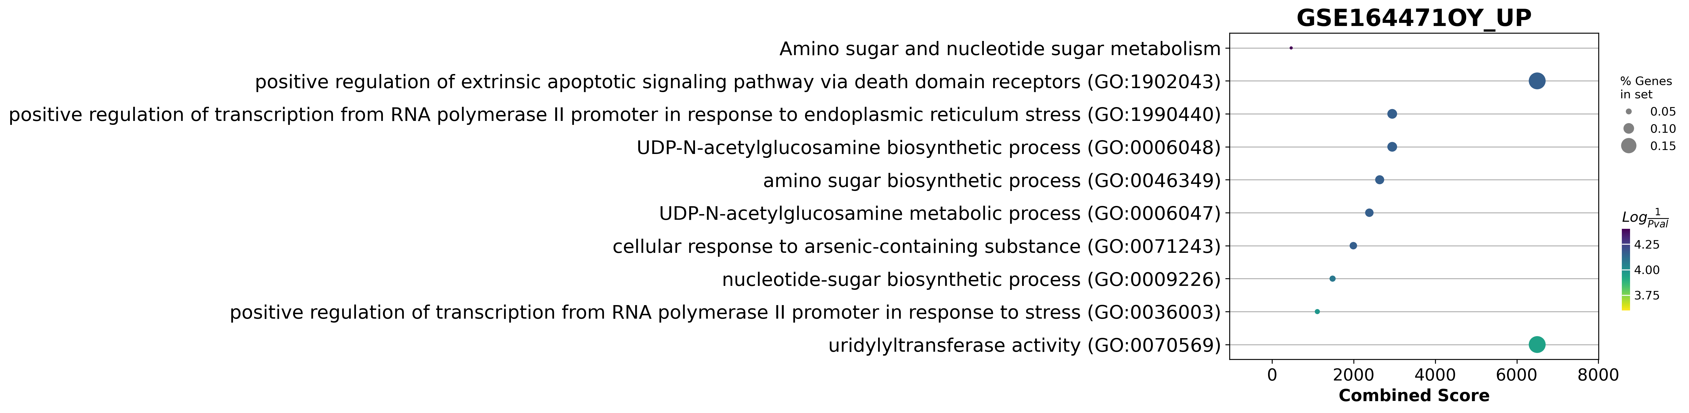
GSE164471 Dotplot
galactose to glucose

Slide 19
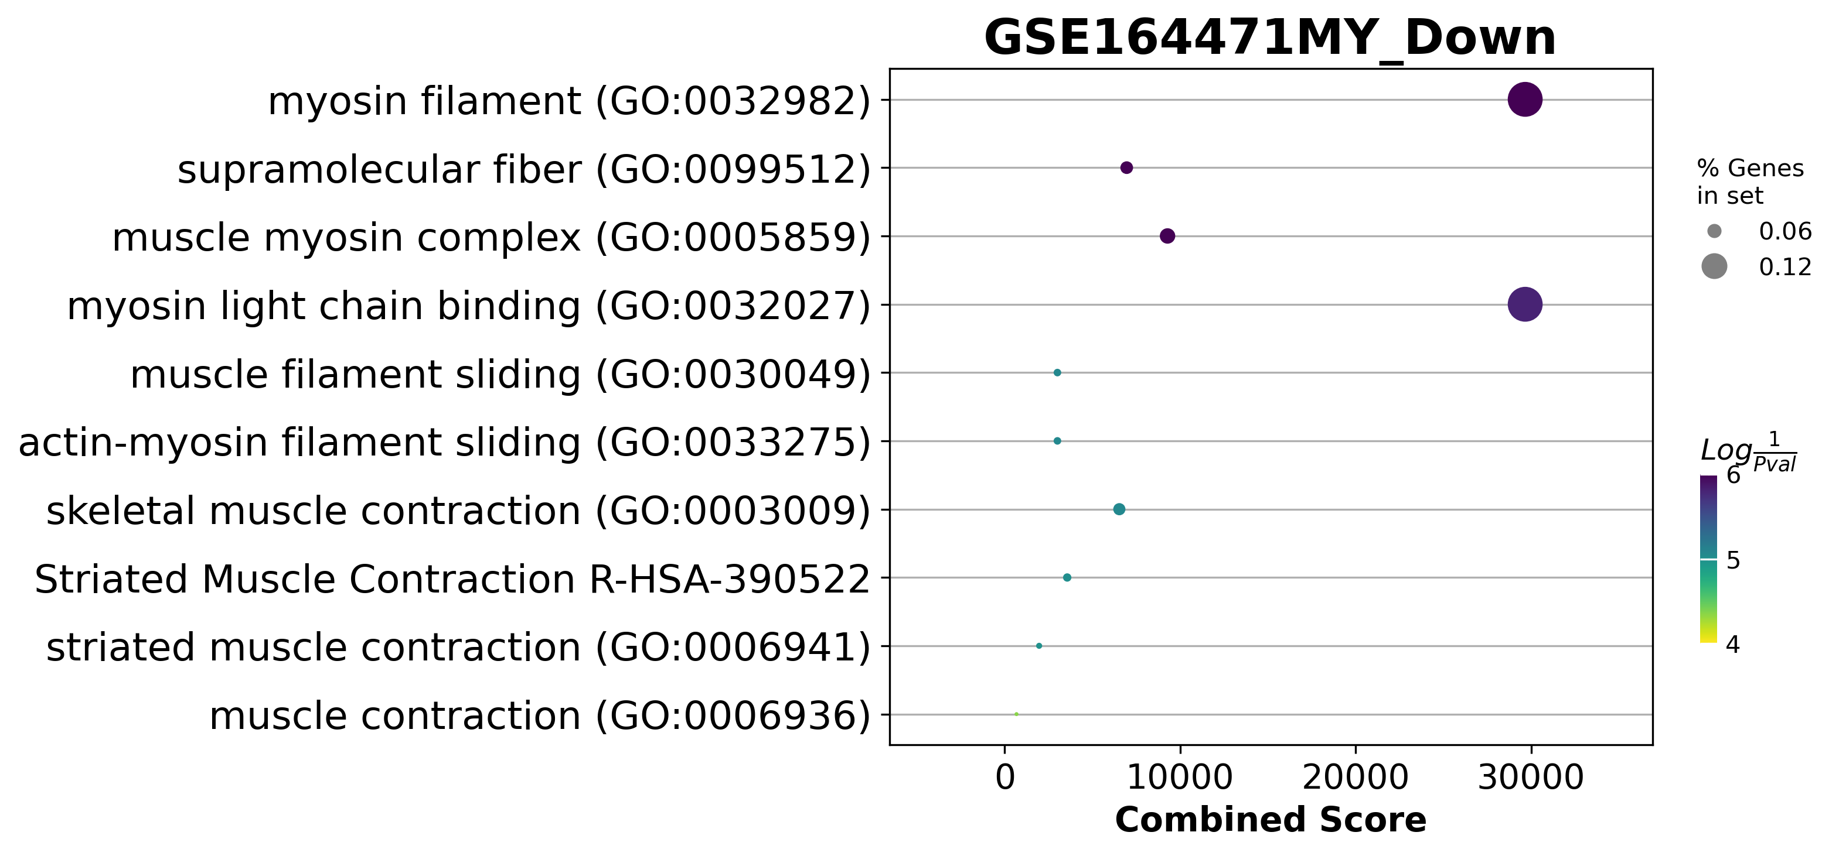
GSE164471Dotplot

Slide 20
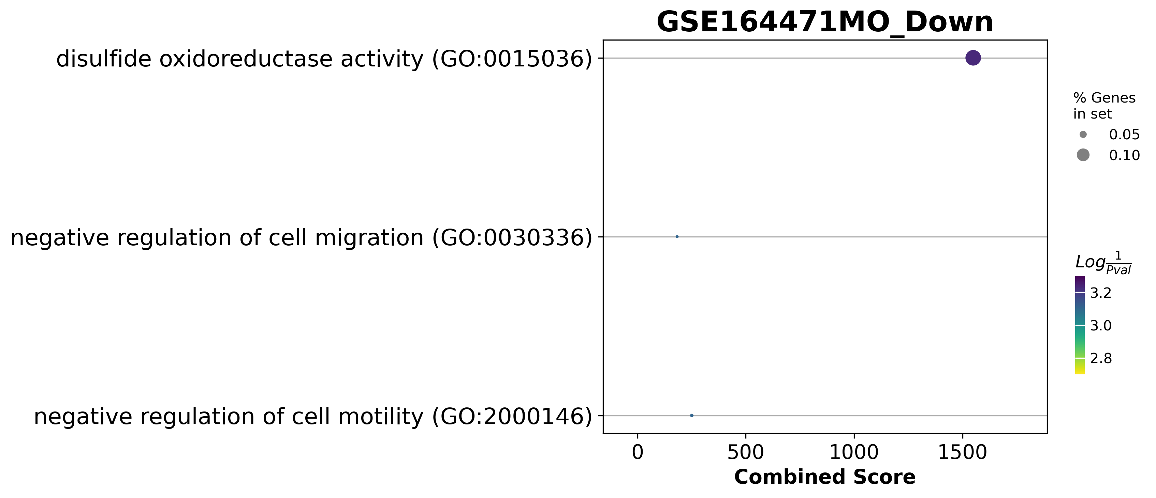
GSE164471Dotplot

Slide 21
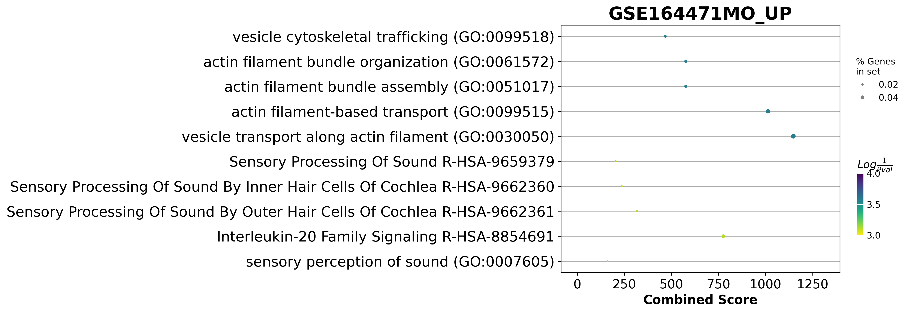
GSE164471Dotplot

Slide 22
GSE164471 was one of the best experiments
Skeletal muscle biopsies were obtained from 53 participants (22–83 years, median = 52 years)
14 Young
21 Middle age
18 Old
if they consumed medication for chronic illness
trained professionally
had a body mass index ≥ 30 kg/m2
were diagnosed with cognitive damage, a physical impairment, or a major disease.

Slide 23
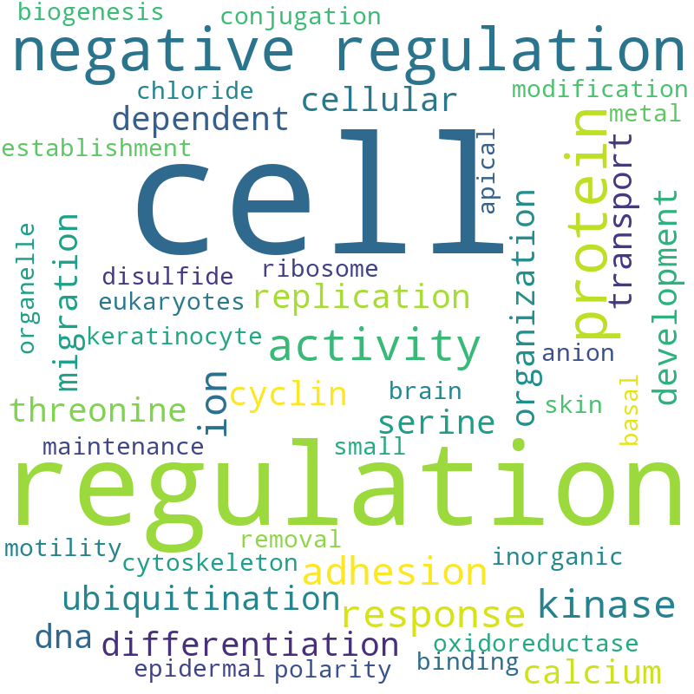
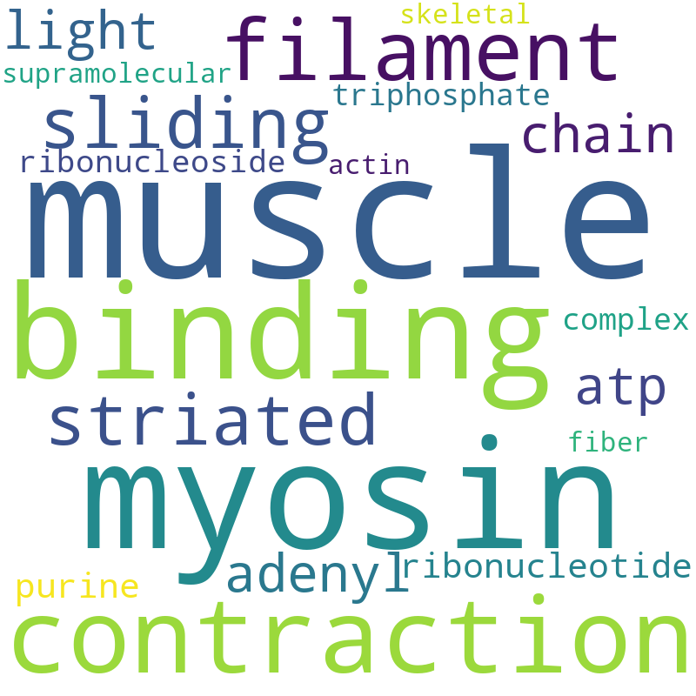
GSE164471(YO) Pathway analysis Word Cloud

Slide 24
GSE164471(YM) Pathway analysis Word Cloud

Slide 25
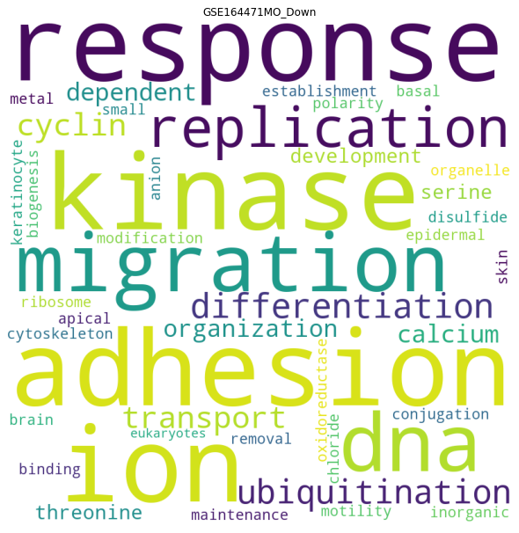
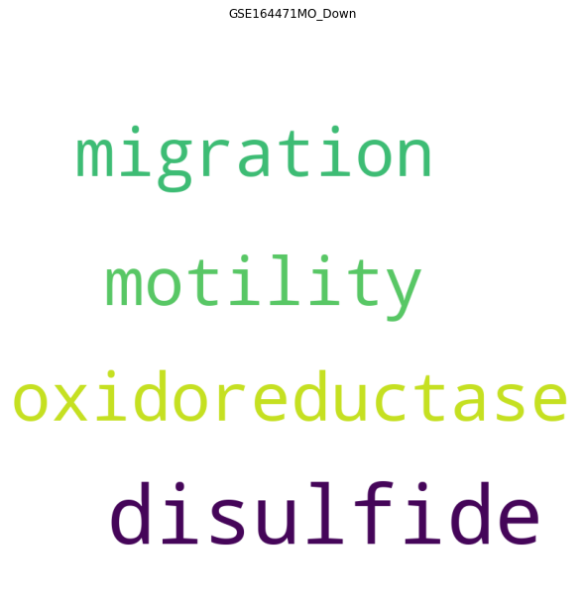
GSE164471(YM) Pathway analysis Word Cloud
Adjust p value < 0.05
Genes pathway coverture > 0

Slide 26
Differential expressed genes

Slide 27
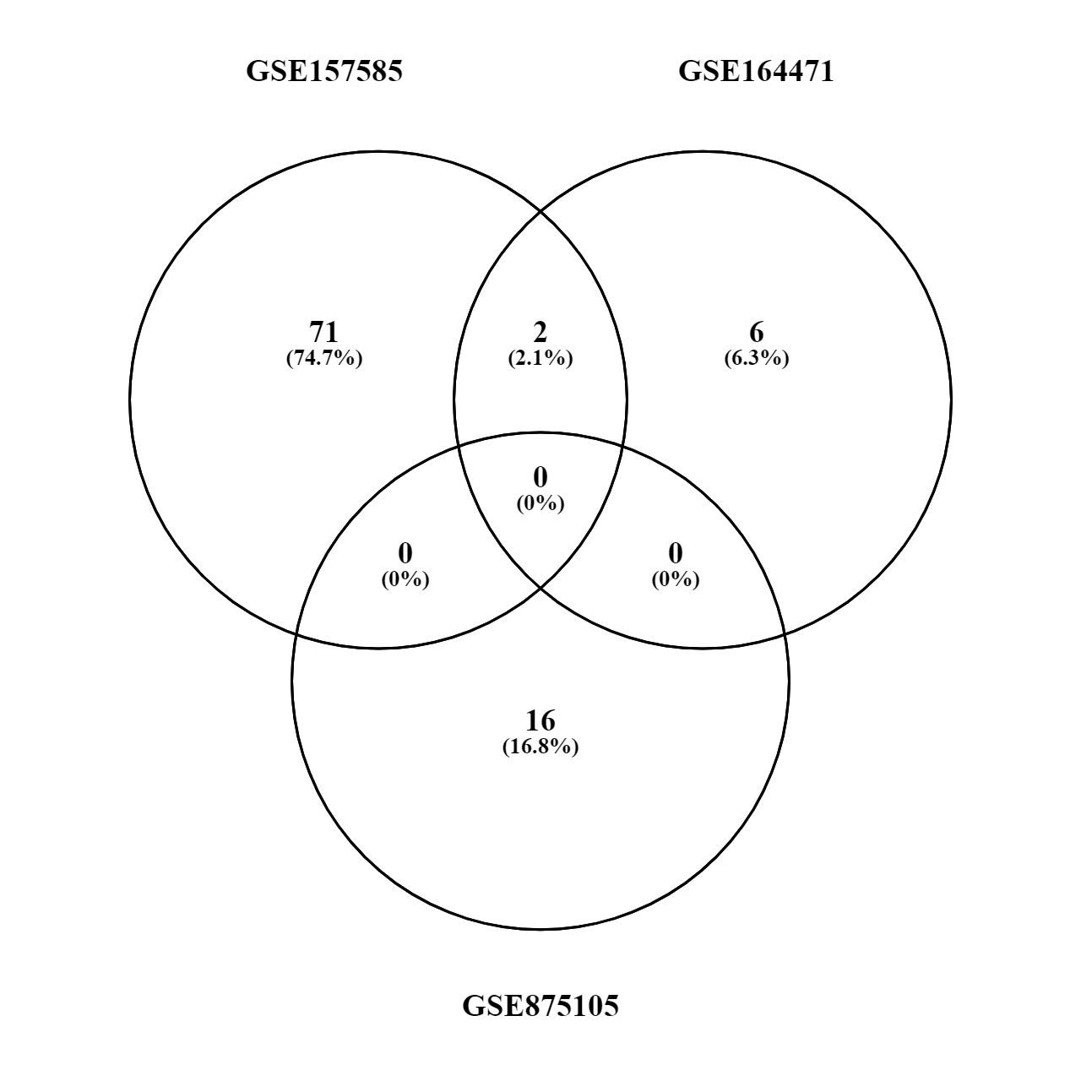
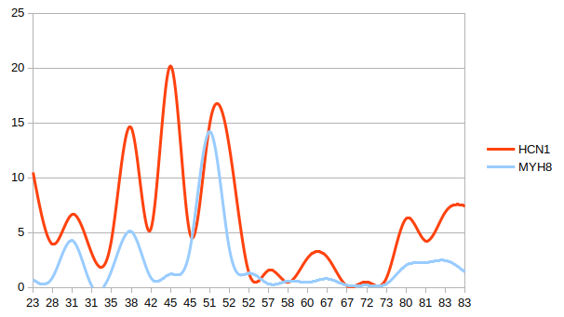
Old vs Young (up or down)
MYH8
HCN1

Slide 28
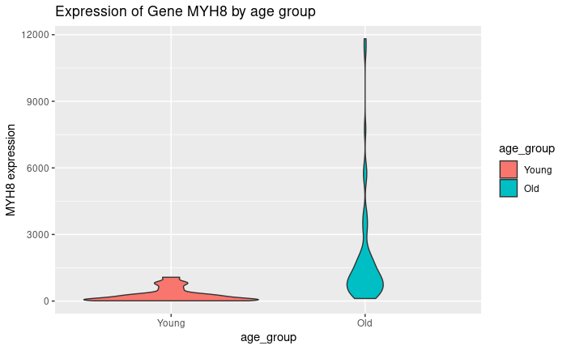
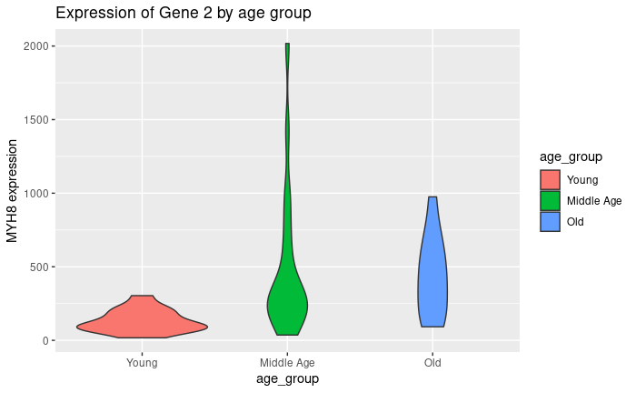
MYH8 raw count over age
GSE157585
GSE164471

Slide 29
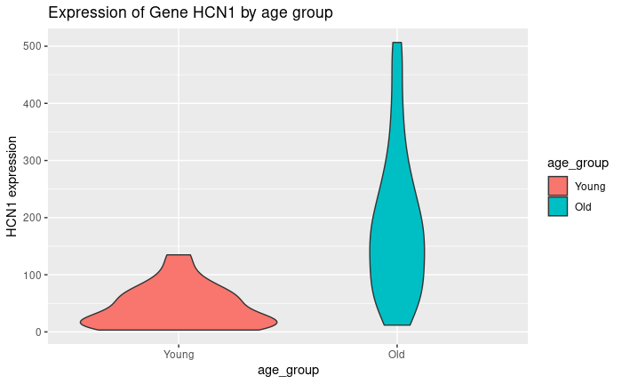
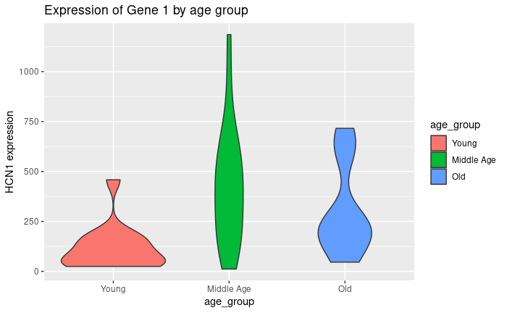
HCN1 raw count over age
GSE157585
GSE164471

Slide 30
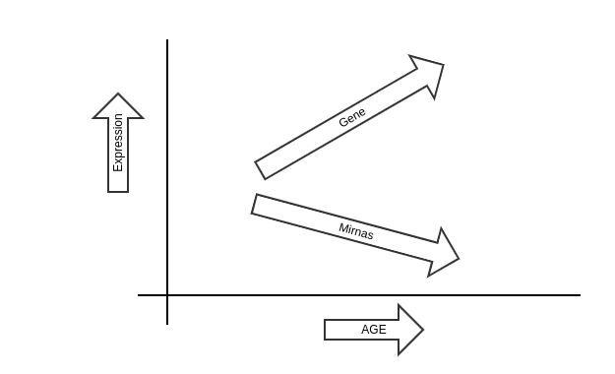
Positive slope

Slide 31
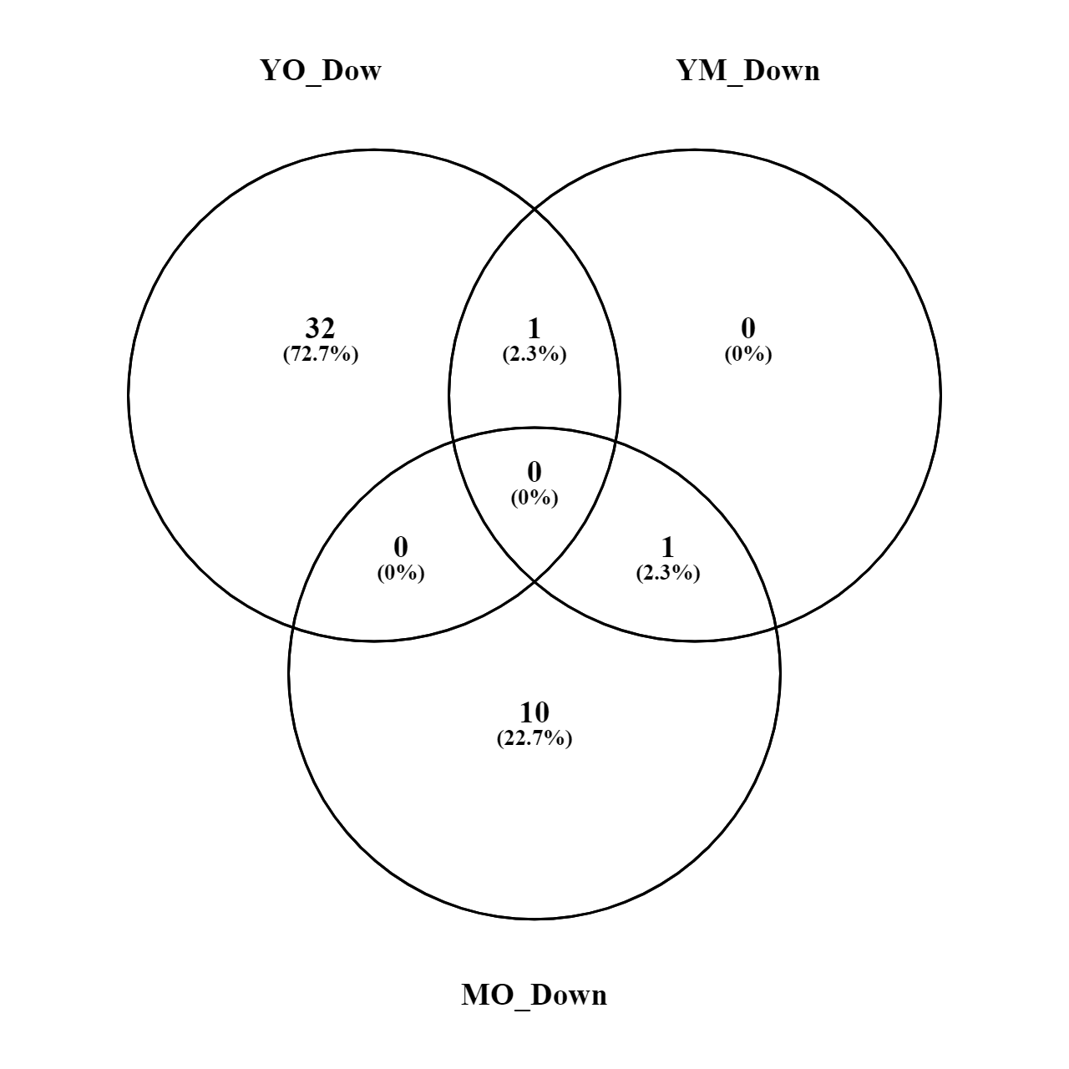
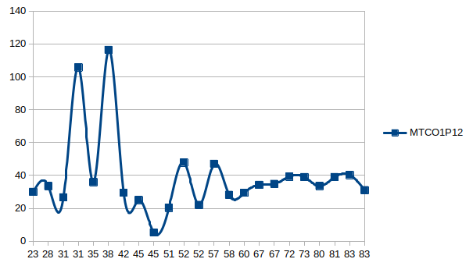
Genes increased by age
MYH8
MTCO1P12

Slide 32
Cytoscape

Slide 35
Acknowledgements
This presentation has emanated from research conducted with the financial support of Science Foundation Ireland under Grant number [18/CRT/6214 ]

Slide 36


Slide 37
Read and get familiarize with:
TargetScan
miRNet
Enrichr
Cytoscape
PathVisio
Ingenuity Pathway Analysis
Complex Pathway Simulator
GENE Expression Omnibus
Xpress

Slide 38
Thank You

Slide 39
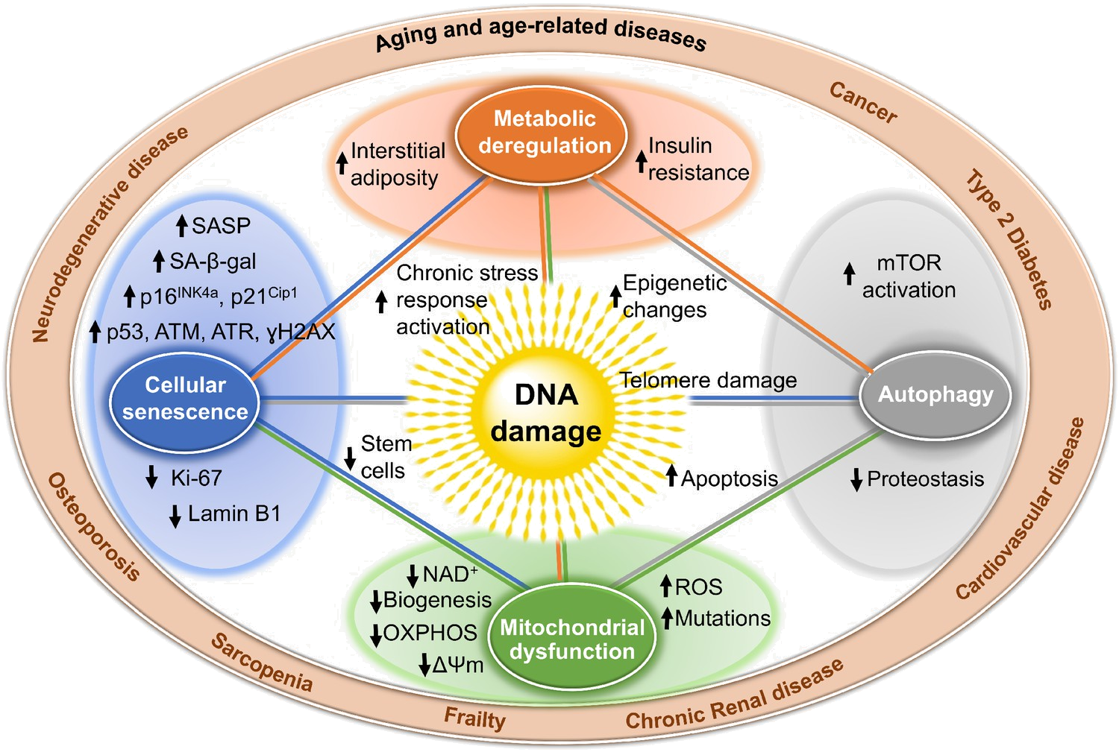
Why miRNAS
Notes:
Well, Aging is the cause of Sarcopenia, but this involves plenty of different processes that make it complicated to approach by isolating one pathway or one gene. And using small molecules work as a preventive method, they don’t regenerate the muscle. , microRNA allows a cleaner approach, because we can know the target and escalate to more parts of the body.

Slide 40
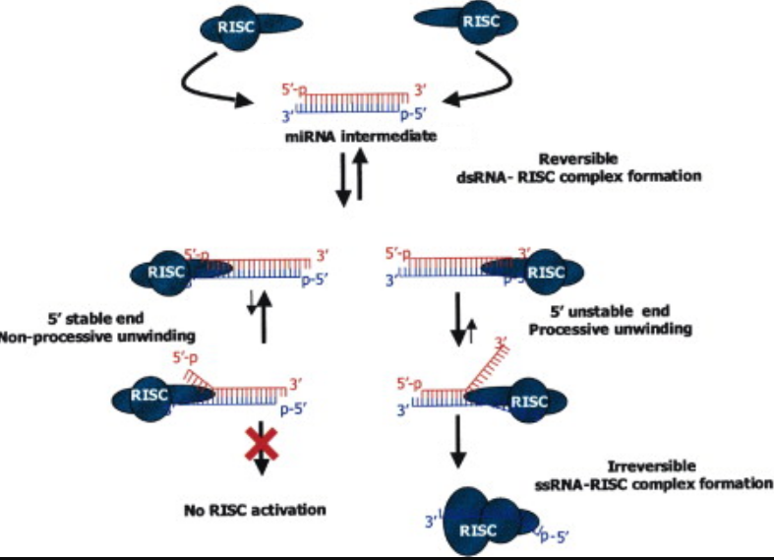
miRNA duplex
Notes:
Edited from https://www.cell.com/fulltext/S0092-8674(03)00801-8

